Slide 1
The Future of Global Trade
Nik C. Colby P. Joey A.

Slide 2
01
AI in Global Trade
Nik C.
Notes:
Slide 1 – Title Just introduce yourself and the topic. Something like: "Today we're looking at how AI and automation are changing the way countries trade with each other — not in theory, but right now. We'll cover supply chains, digital trade, and finish with a debate you'll all get to weigh in on."

Slide 3
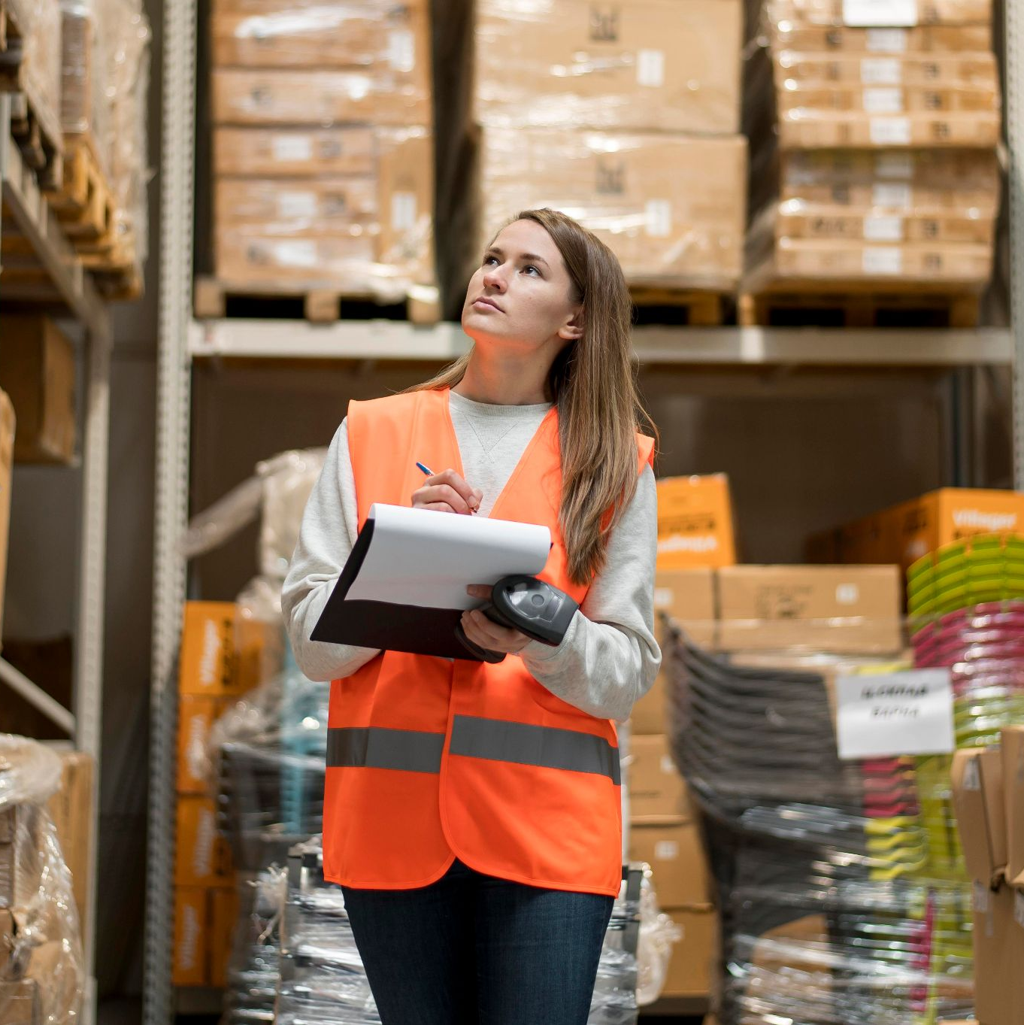
AI in Global Trade
Predictive logistics
Automated customs clearance
  Ex) DHL uses AI to reroute shipments around disruptions automatically
Result: lower costs, faster delivery, fewer human errors
Notes:
Slide 4 – AI-Powered Supply Chain Optimization "Traditional supply chains were reactive — something breaks, you scramble to fix it. AI flips that. Predictive logistics means a company already knows a port will be congested next week and reroutes shipments today. Automated customs clearance is another big one — what used to take days of paperwork can now be processed in seconds using machine learning. DHL, for example, uses AI to automatically reroute packages around disruptions in real time. The net result is lower costs, faster delivery times, and fewer expensive human errors at every step."

Slide 4
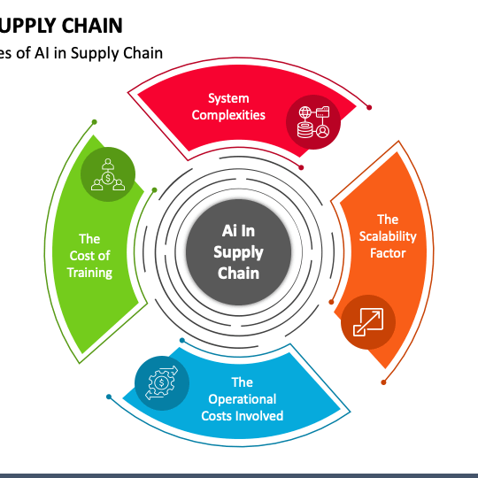
AI in Global Trade
Tariff impact forecasting
Improved fraud detection
Supplier risk scores
  Example: U.S. customs uses AI to screen 50,000+ daily trade entries for fraud
Firms can now react to policy changes in hours
Notes:
Slide 5 – AI-Driven Trade Decision-Making "This slide is about how individual firms use AI to stay competitive in a world where trade policy can change overnight. During the U.S.-China trade war, companies needed to model the impact of new tariffs on their margins almost immediately — AI made that possible. Trade fraud is also a massive problem, costing the global economy hundreds of billions a year, and AI is now the primary tool to catch it. U.S. customs screens over 50,000 trade entries per day using AI to flag suspicious shipments. The broader point is that firms can now react to policy changes in hours rather than weeks."

Slide 5
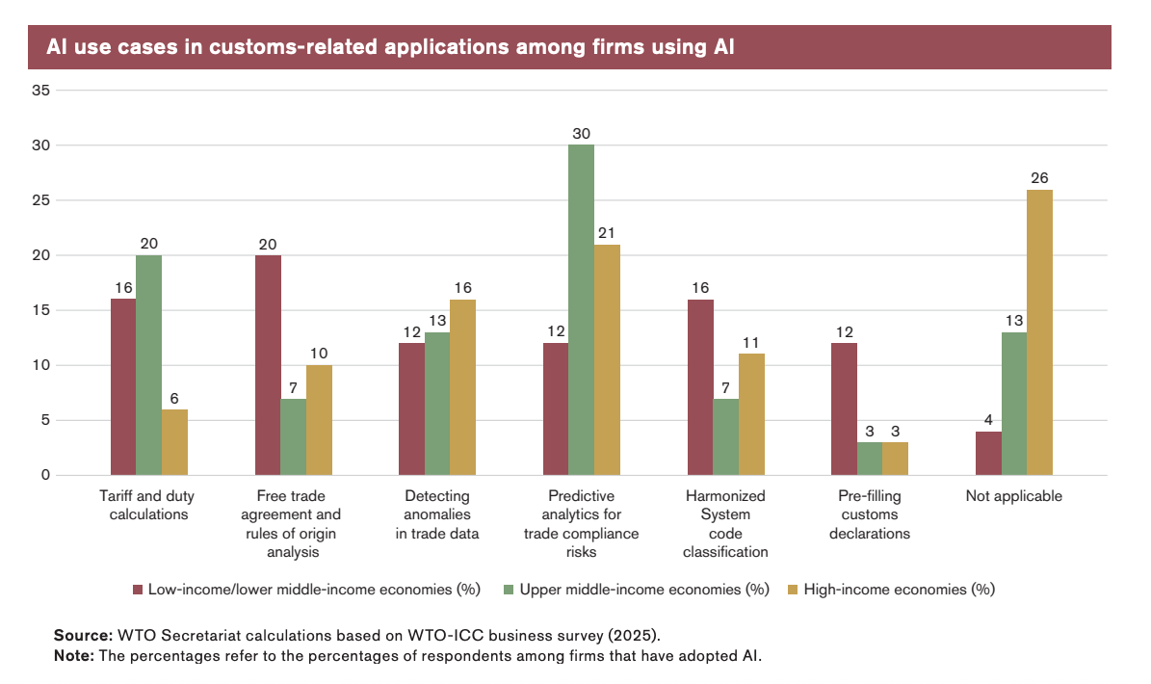

Slide 6

The Digital Twin
Virtual replica of an entire supply chain
Companies run simulations
Identifies single points of failure before a real crisis hits
Notes:
Slide 6 – Digital Twins "A digital twin is basically a live virtual replica of your entire supply chain — every supplier, warehouse, shipping route, and inventory level mapped in real time. The value is that you can run simulations before a crisis hits. What happens to our operations if the Suez Canal closes? What if a key supplier in Vietnam goes offline? Unilever does this across over 500 suppliers. After the Ever Given blocked the Suez in 2021, hundreds of companies were completely caught off guard. Digital twins are how you avoid being one of them."

Slide 7
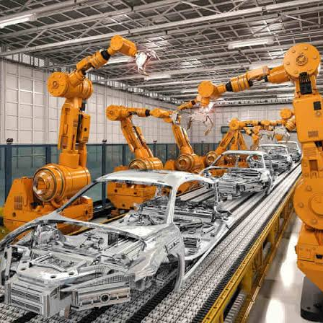
Automation & Robotics in Manufacturing
Smart factories: robots handle all aspects of production
Automated ports
China's Tianjin port shandles 21M+ containers/year
Amazon: 750,000+ robots in fulfillment centers alongside human workers
Notes:
Slide 7 – Automation & Robotics "Smart factories are no longer futuristic — they're operational. Robots handle assembly, quality checks, and packaging around the clock without breaks or errors. Ports are arguably the most striking example: China's Tianjin port is fully automated and moves over 21 million containers a year with almost no human workers on the dock floor. Amazon has over 750,000 robots in its fulfillment centers right now working alongside human employees. The key tension here — which we'll come back to in the debate — is that while output per worker rises dramatically, the question of who actually benefits from those efficiency gains is a real one."

Slide 8
Impact on Developing Economies
Risks
Opportunities
Automation erodes low-cost labor advantage
Reshoring trend
Lack of infrastructure to adopt AI
Risk of being cut out of global value chains
AI lowers entry barriers for small exporters
Access to global logistics platforms
Efficiency gains improve competitiveness
Notes:
Slide 8 – Impact on Developing Economies "This is one of the most important and nuanced parts of the whole topic. Developing nations like Bangladesh, Vietnam, and Ethiopia built their growth models around cheap labor — manufacturing goods for export at a cost advantage over richer countries. AI and automation directly threaten that model, because a robotic textile factory in Germany can increasingly undercut a garment worker in Dhaka on cost. At the same time, platforms like Alibaba have genuinely opened global markets to small businesses in Africa and Southeast Asia that couldn't have accessed them before. So the picture is mixed — the opportunities are real, but so is the risk of being cut out of global value chains entirely."

Slide 9
02
DIGITAL TRADE & E-COMMERCE

Slide 10
Digital Trade Stats
$6.3T
3x
Global e-commerce revenue in 2024
Faster growth than the goods trade
22%
Cross border share of e-commerce
Notes:
Slide 10 – Digital Trade by the Numbers "These numbers put the scale in perspective. Global e-commerce hit $6.3 trillion in 2024. About 22% of that is cross-border — people buying from sellers in other countries. And digital trade has been growing three times faster than physical goods trade since 2005. That gap is only going to widen. When we talk about 'trade' in an international economics class, we need to include this, because it's now a central part of how the global economy works."

Slide 11
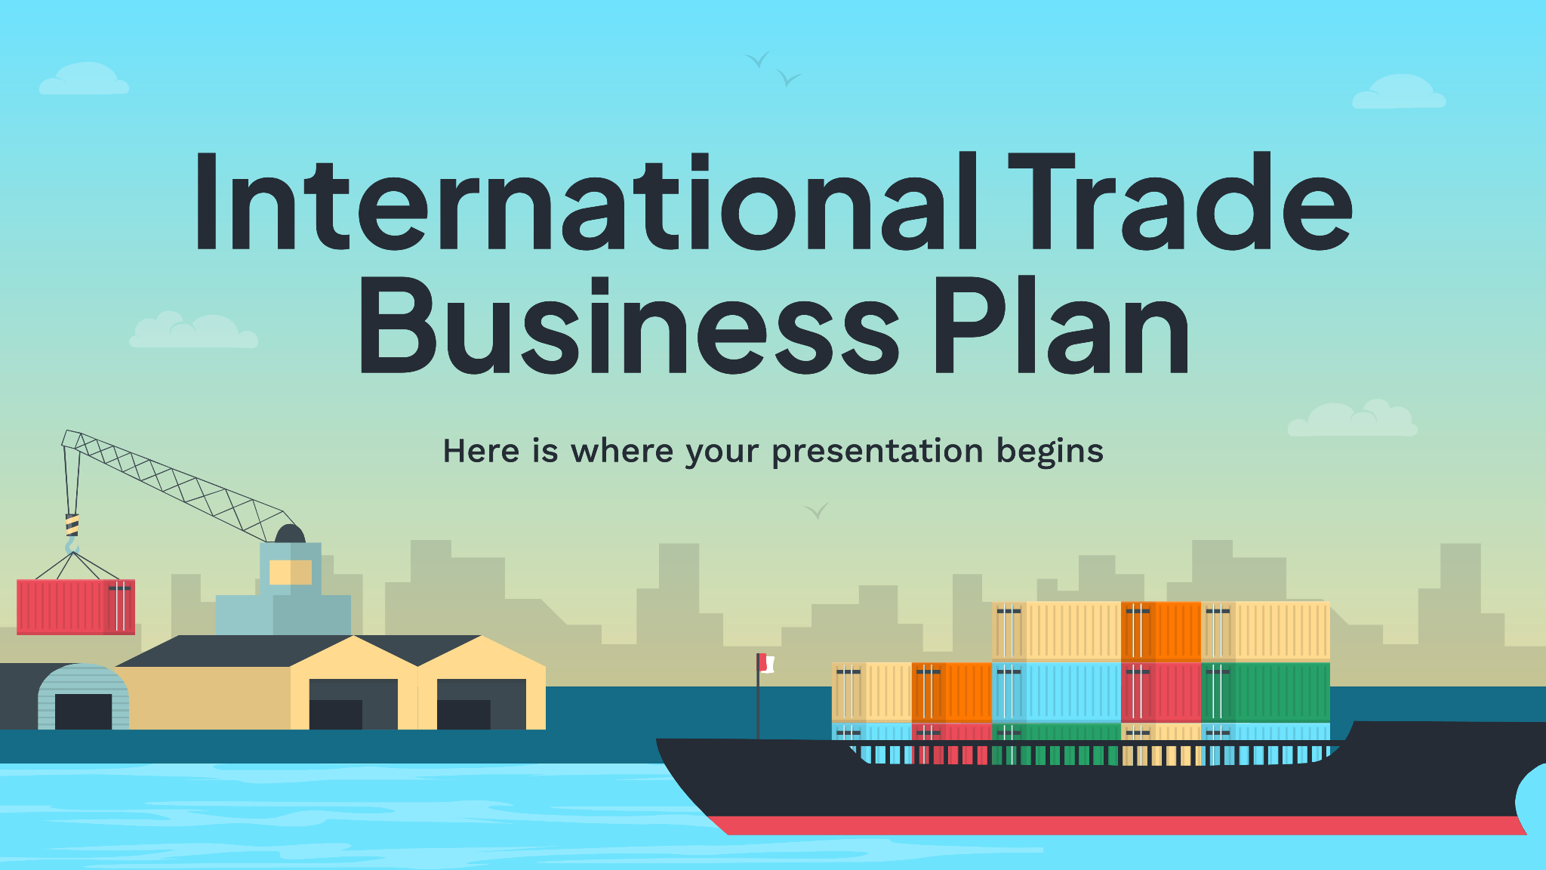
How has digital trade changed commerce
International e-commerce connects buyers worldwide
Cloud services, streaming, etc.
Removes FX friction (Stripe)
SMEs can export from day one
Notes:
Slide 11 – How Digital Trade Is Transforming Commerce "The really important conceptual shift here is that data itself has become a tradeable good. When a U.S. company uses AWS servers in Ireland to serve European customers, that's a trade transaction. When someone in Brazil buys a software subscription from a company in South Korea, that's trade. Fintech has been a huge enabler of all this — platforms like Stripe and Wise removed the friction of cross-border payments that used to be a major barrier for small businesses. The upshot is that a small business can now be a global exporter from day one, with no warehouse, no freight forwarder, and no physical presence abroad."

Slide 12
Challenges of Digital Trade
Data / Regulations
Cybersecurity/ IP
Data localization laws
EU vs. U.S. approach = conflicting privacy
Digital services taxes
Privacy concerns
IP theft costs global economy $600B+ per year
State-sponsored cyber espionage targeting trade secrets
Small firms lack resources to defend against sophisticated attacks
Notes:
Slide 12 – Challenges of Digital Trade "The core problem is that digital trade has scaled enormously, but the regulatory framework governing it is fragmented and outdated. Data localization laws — where countries like China, Russia, and India require certain data to be stored on local servers — are essentially new trade barriers in digital form. The U.S. and EU have been fighting for years over conflicting privacy frameworks: GDPR in Europe is far stricter than U.S. law, which creates real friction for American tech companies operating there. On the IP side, theft costs the global economy over $600 billion a year, and a lot of it flows through e-commerce platforms. The WTO's TRIPS agreement was designed for a physical world and hasn't kept pace."

Slide 13
Class Debate
Will AI & Automation Create Opportunity or Job Losses?

Slide 14
What we said…
More Opportunity
Job Displacement
New industries emerge
Lower trade costs open markets for more firms
Automation in agriculture → industrial jobs → service jobs
AI handles dangerous/repetitive work
Developing nations lose labor-cost advantage overnight
Transition is painful and retraining takes years
Benefits concentrated in capital owners, not workers
Notes:
Slide 13 – Class Debate "So here's where it lands. The optimistic view says this is just the latest in a long series of technological transitions — automation in agriculture pushed workers into factories, factories pushed workers into services, and the economy as a whole got richer each time. New industries emerge, costs fall, markets expand. The pessimistic view says this wave is different: it's faster, it hits cognitive work not just physical labor, and the benefits are accruing to capital owners while workers bear the transition costs. The key question worth arguing is not just whether jobs disappear, but who bears the cost of the adjustment — and whether policy has any business trying to slow the transition down."

Slide 15
Key Takeaways
AI is making supply chains faster and smarter but also more concentrated in tech-rich nations
Digital twins and predictive analytics are shifting trade from reactive to proactive
Digital trade is the fastest-growing part of global commerce
Regulation hasn't kept up, ei data localization and IP theft remain unresolved

Slide 16
02
From Global Integration to a More Fragmented System
Colby P

Slide 17

From Global Integration to Fragmentation
Regional concentration of trade
  Trade increasingly happening within regions (e.g, Europe, Asia)
Coexistence of multiple trade layers
  Example: EU (regional), WTO (global), USMCA (bilateral/regional)
Trade-offs: Efficiency vs. Resilience
  More efficiency → lower costs but higher risk
  More resilience → higher costs, but greater security
Notes:
Real world example for efficiency vs. resilience: Before covid, it was more efficiency focused as companies produced goods in one low-cost country (China) and this was cheap and fast. However, during Covid, factories shut down, causing supply chains to collapse. In turn, after covid, there was a resilience shift with more suppliers, more inventory which was reliable but the costs were higher

Slide 18

Changing Patterns of Integration
Shifts in global production networks
Uncertainty reshaping trade
Rise of “de-risking”
Example differences
  Asia: highly integrated supply chains
  Europe: strong regional trade blocs
  Global South: growing but less centralized networks
Notes:
Shifts in global production networks: “China +1 Strategy → Firms add countries like Vietnam or India, Supply Chains become more flexible
Uncertainty reshaping trade: Covid 19 wars, and political tensions disrupted flows, firms now prioritize risk mamagement
Rise of “de-risking”: Countries reduce independence without cutting ties completely, Trade continues, but with more partners

Slide 19

Role of Institutions & Cooperation
Challenges to cooperation
  More geopolitical tensions → harder to agree globally
  Countries prioritize national security and independence
Changing roles of institutions
  Organizations like the WTO face limits in enforcement
In conclusion…cooperation is weakening globally but not disappearing

Slide 20
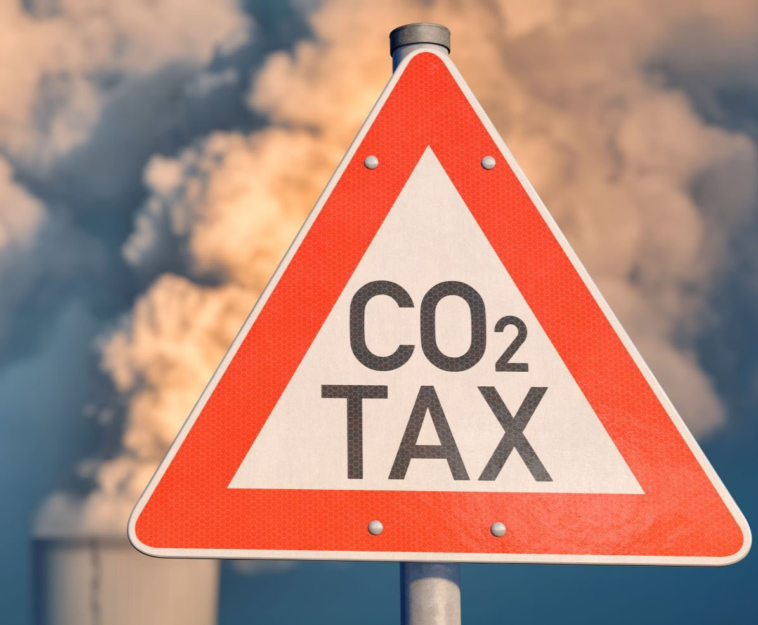
Alternative Paths to Cooperation
Ways Countries are Working Together:
Flexible and Informal Frameworks
  Smaller agreements instead of large global ones
  Faster and more adaptable to change
Regional Cooperation Increasing
Issue-specific coordination
  Focus on areas like climate, technology, or supply chains (Ex: EU’s carbon border taxes)
Notes:
Regional Cooperation increasing: Countries trade more with nearby partners
Carbon Border Tax: Applies equivalent carbon costs to imports of steel, aluminum, cement, and fetilizers

Slide 21
Class Debate
Is global trade becoming fragmented, or simply reorganized?

Slide 22
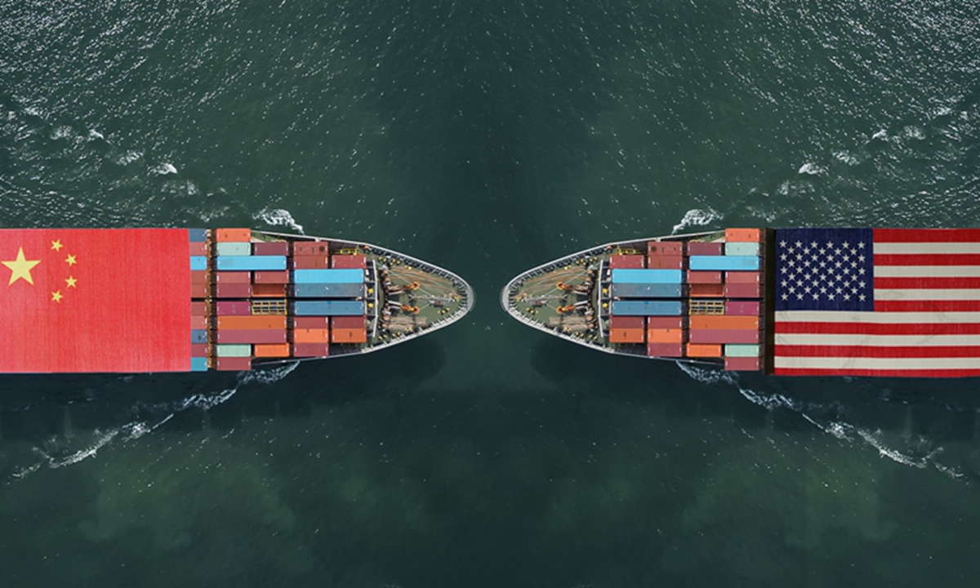
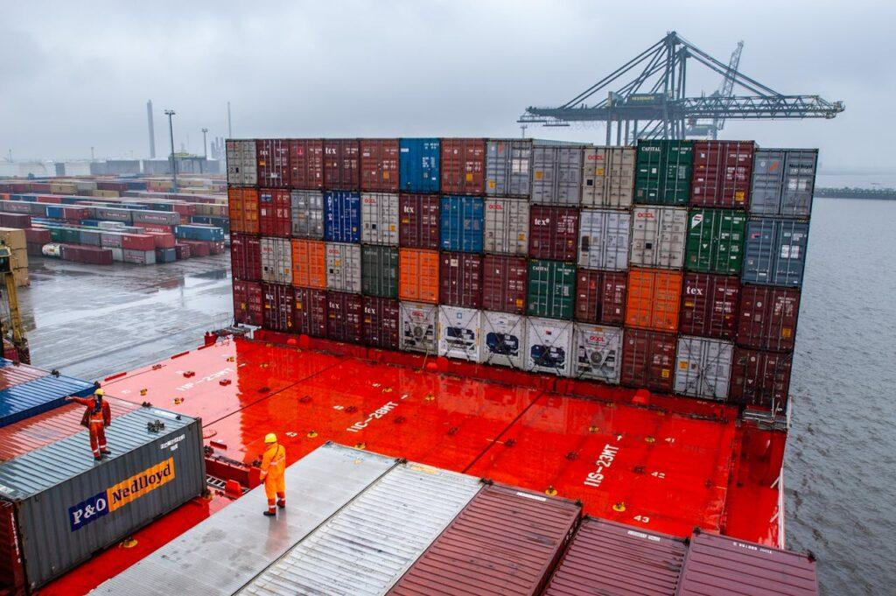
Fragmenting or Reorganizing?
Fragmentation
  Trade blocs forming
  Less global coordination
Reorganizing
  Trade still growing, just structured differently
  More diversified and resilient systems
  Digital and services trade expanding
  Services trade growth- 5-6% annually

Slide 23
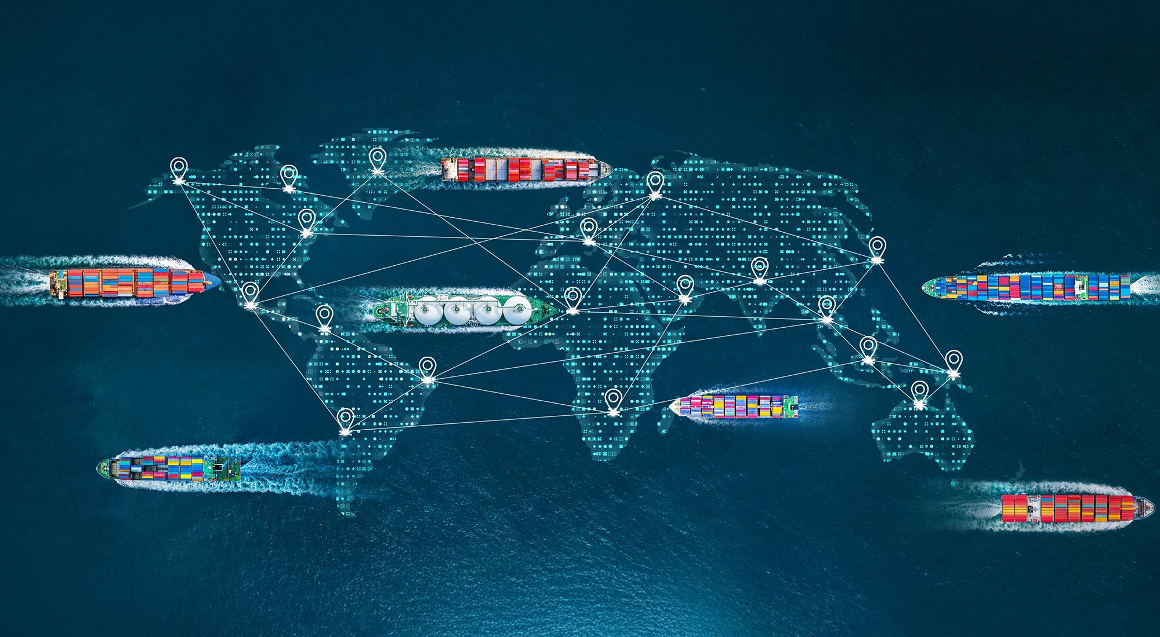
In conclusion…
Global trade is not declining, it’s evolving
Shift from efficiency → resilience
Rise of regionalization
Growth of issue-specific cooperation
More complex global system

Slide 24
Future of Global Trade
Joey Alto
Part 3
Sources: World Bank (2023), IMF World Economic Outlook, OECD Trade Reports

Slide 25
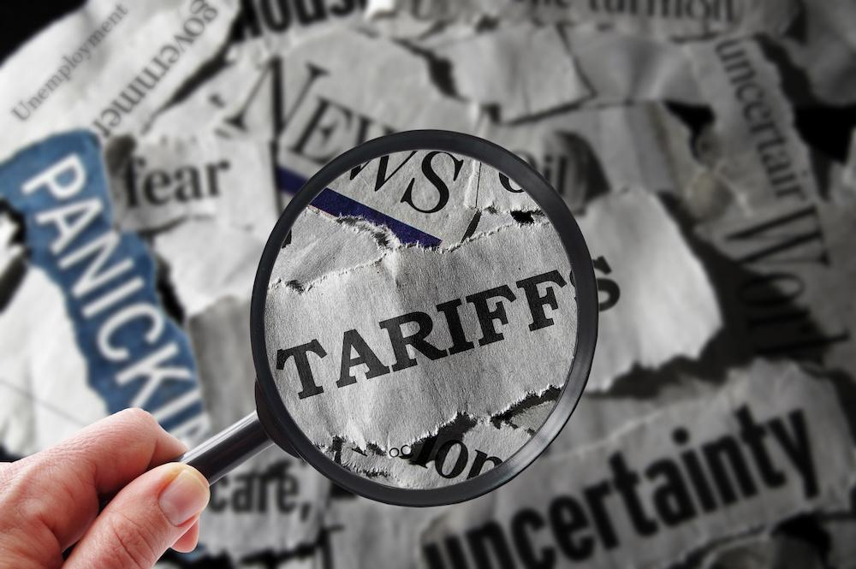
Rising Uncertainty in Global Trade
Trade Wars
Supply Chain Shocks
The U.S.-China trade war introduced tariffs that disrupted global supply chains
Semiconductor shortages slowed the production of cars worldwide
COVID Disruptions
Geopolitical Tensions
Covid shut down factories and ports, creating massive delays.
For example, the Russia-Ukraine War has disrupted energy and food markets, especially in Europe.

Slide 26
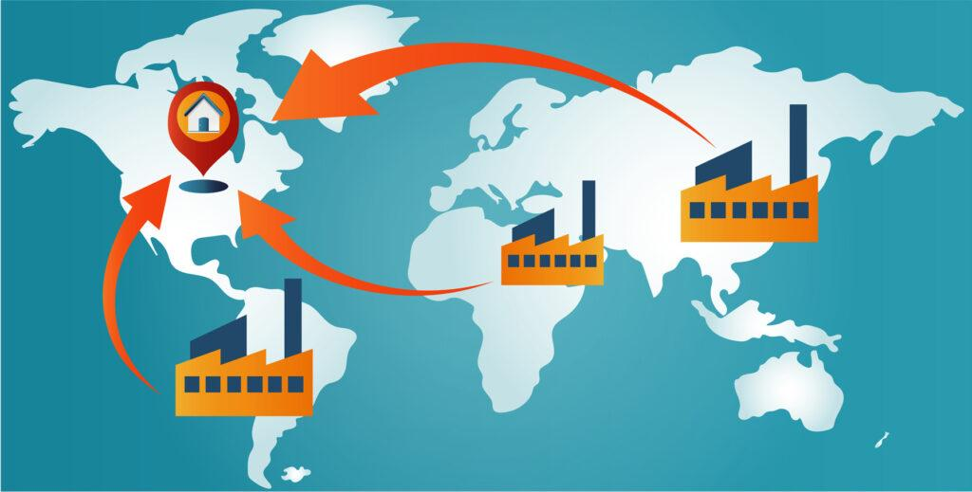
How Firms are Adapting
Supplier diversification to reduce geopolitical risk (OECD)
Nearshoring to improve resilience (e.g., US–Mexico supply chains) (World Bank)
Inventory buffers increasing costs but reducing disruptions (IMF)
AI + data used for risk forecasting (WTO reports on digital trade)
Notes:
Why this matters: Higher costs, less efficiency, more resilience, stable supply chains
These strategies make firms safer, but more expensive. Producing in multiple countries or closer to home increases costs compared to cheap offshore production. Producing in China is cheap vs U.S./Mexico, which is more expensive, but safer

Slide 27
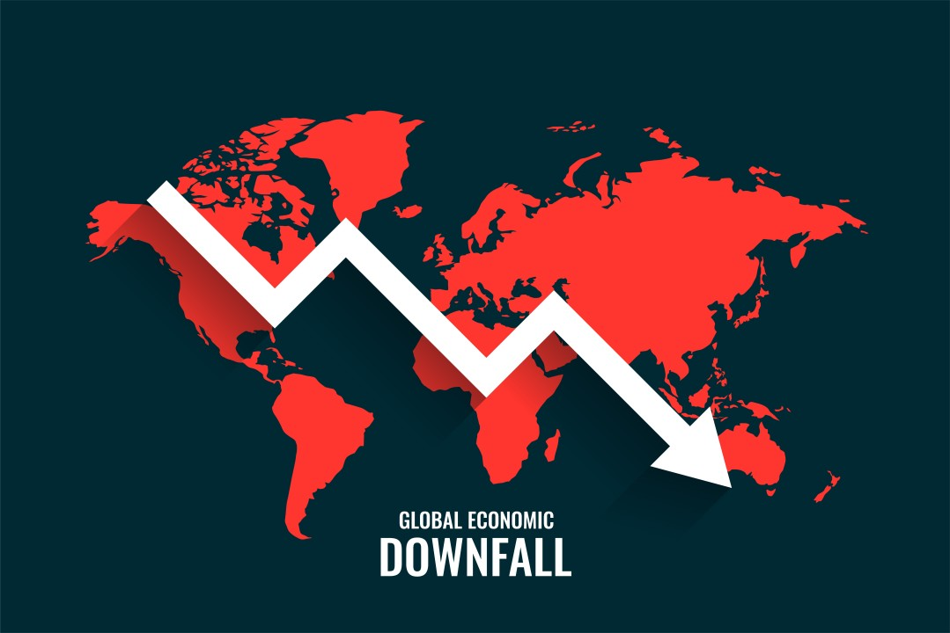
Long-Term Impacts
Regionalization → divergence in trade patterns (WTO)
Fragmentation → higher production costs (IMF)
Higher costs → lower trade efficiency & slower growth (World Bank)
Uneven adaptation → greater global inequality (OECD)
Notes:
In the long run, these changes could reshape the global economy. Less efficient production can slow global growth. Also, countries that are excluded from supply chains—especially developing nations—may fall behind.
Examples:
Countries like Vietnam benefit from supply chain shifts
Others lose investment if firms relocate

Slide 28
Future of Global Trade
Examples:
USMCA strengthening North American production
EU sourcing more within Europe
Asia centered around China-led supply chains
Regional trade blocs expanding (EU, RCEP, USMCA) (WTO)
Trade becoming reorganized not necessarily declining (IMF)
Supply chains reorganized around geopolitical alliances (OECD)

Slide 29
Possible Future Scenarios
Fragmented system → regional trade blocs dominate, global is weaker(WTO)
De-risked globalization → diversified, not fully global (IMF)
Hybrid system → regional goods + global services (OECD)
Hybrid + de-risking is most likely due to balance of efficiency and resilience

Slide 30
Hybrid Trade System
Examples:
Software, finance, and consulting services traded globally
Remote work and outsourcing increasing cross-border services
Regional production hubs for goods
Global trade in services & data flows (WTO)
Digital trade growing faster than goods (World Bank)
Notes:
The future system will likely be hybrid. Physical goods will be traded regionally, but digital trade- like services and technology- will be global.

Slide 31
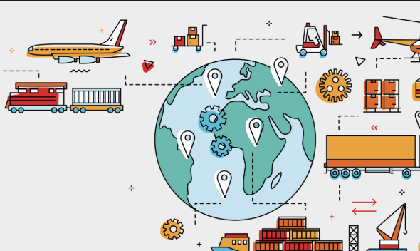
Technologies Role
AI → smarter, faster supply chains (WTO)
Digital trade growing faster than goods (World Bank)
Automation → reshaping production locations (OECD)
Tech reduces costs but increases inequality risks (gas flaring, manufacturing)

Slide 32
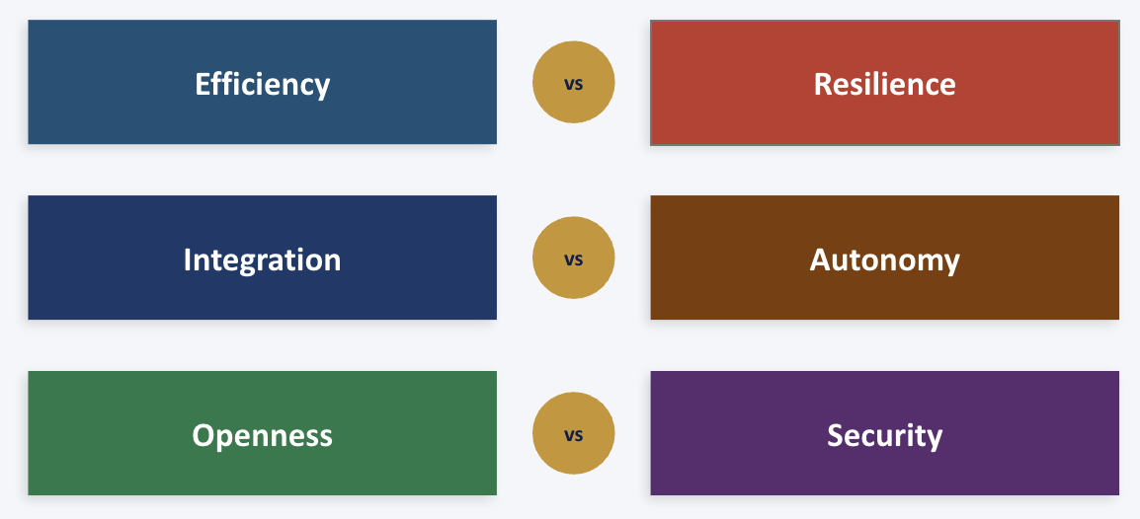
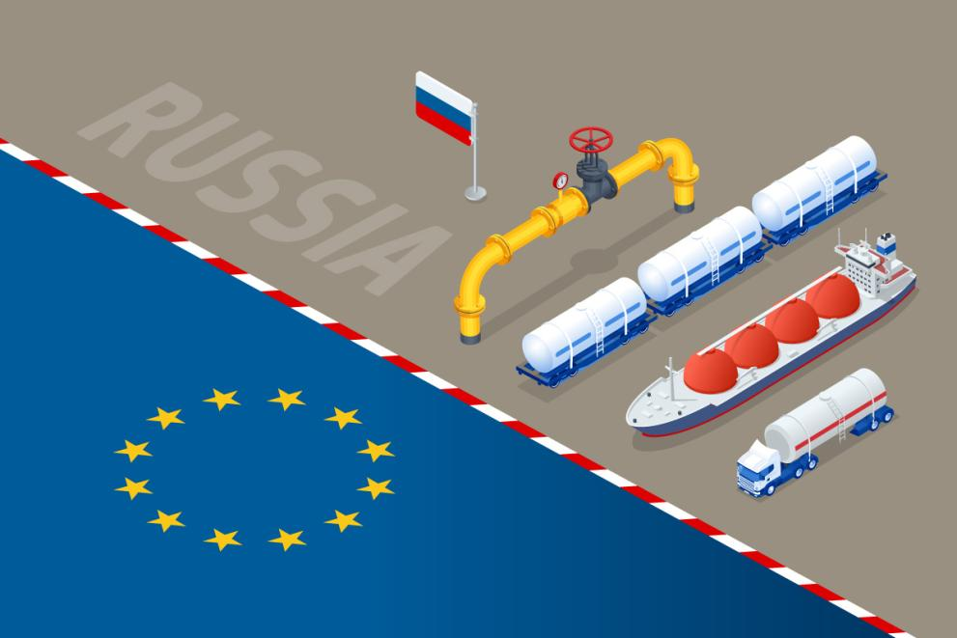
Key Trade-Offs
Efficiency vs. Resilience
Integration vs autonomy
Cost vs security
Examples:
Efficiency vs resilience → cost vs stability
Integration vs autonomy → globalization vs national security
Openness vs security → cheaper imports vs safer supply chains
Notes:
These are the biggest countries and firms face. Do they priortize cheap production or stable supply chains? Do they stay globally integrated or become more self-sufficient?

Slide 33
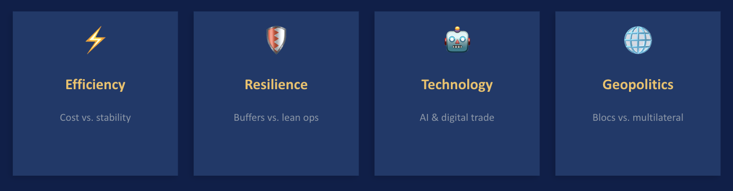
In conclusion…
Global trade is restructuring, not collapsing (WTO)
Most likely outcome: hybrid + de-risked system
Firms prioritizing resilience over efficiency
Trade shaped by:
geopolitics
supply chains
economic security

Slide 34
Class Debate Question:
" What trade-offs will define the future of global trade: efficiency,
resilience, technological change, or geopolitical security?"

Slide 35

Thanks!
Do you have any questions?

